Slide 1
Tensorflow basics – part 1
Prof. Yong Won SEO, Ph.D.
College of Business and Economics
Chung-Ang University

Slide 2
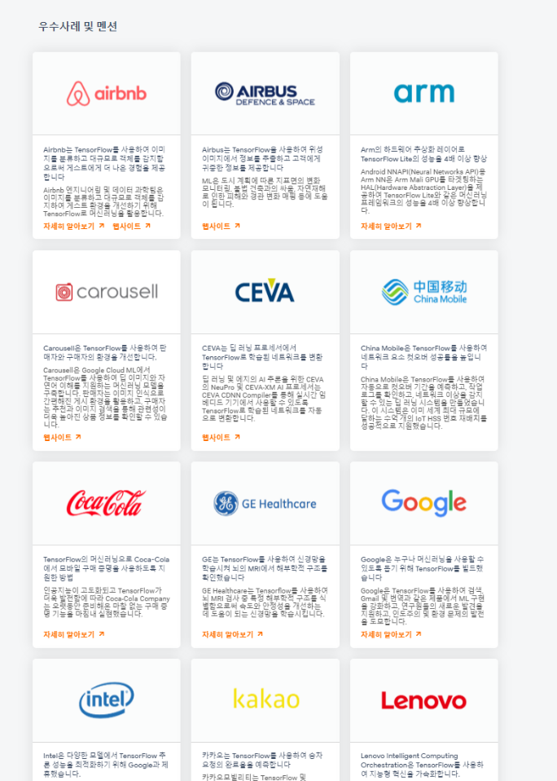
https://www.tensorflow.org/about/

Slide 3
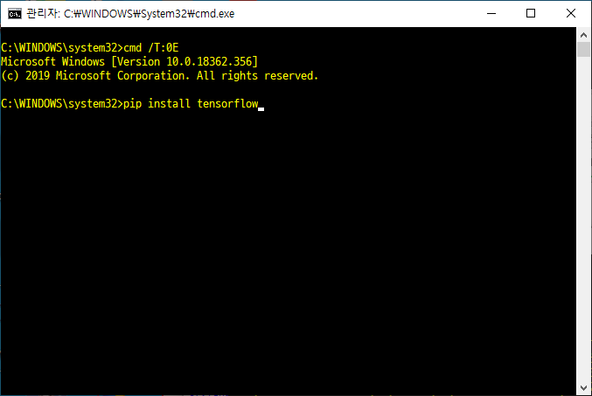
install tensorflow

Slide 4
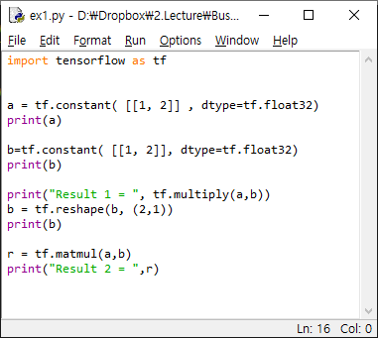
defining tensors
https://www.tensorflow.org/api_docs/python/tf

Slide 5
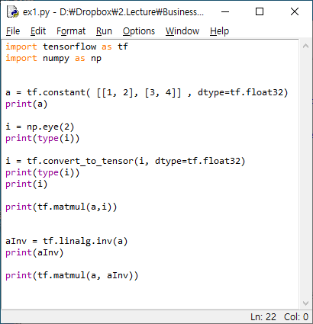
identity matrix and inverse

